Slide 1
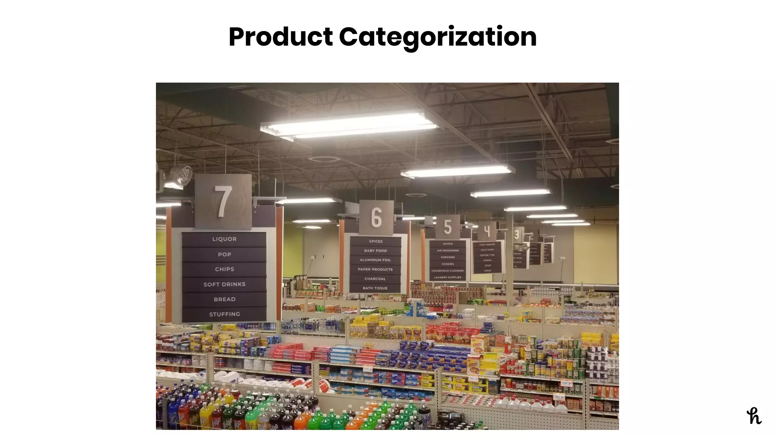
E-commerce Product Categorization
Analyzing and Predicting Product Categories
Presented By- Poorvi Dubey

Slide 2
Introduction
Problem: Ecommerce websites often struggle with accurate and consistent product categorization, leading to a poor customer experience and ineffective search functionality.
Objective: Develop a machine learning model that accurately categorizes ecommerce products based on their descriptions.
Significance: Accurate and consistent product categorization can improve customer experience, increase sales and revenue, and provide a scalable and replicable solution for ecommerce businesses.

Slide 3
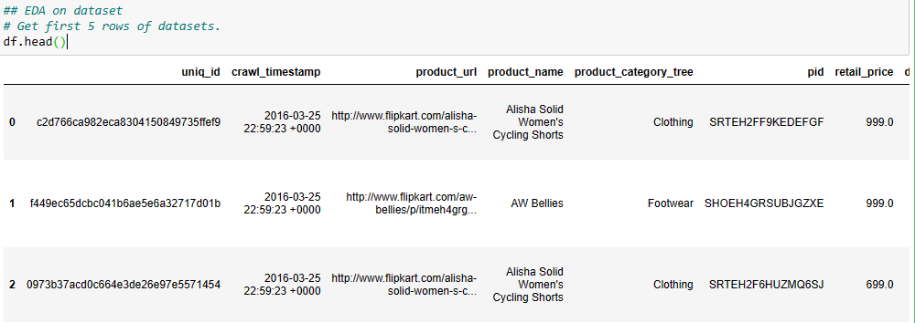
Data Preprocessing
Handling missing values and nulls Removing unwanted features

Slide 4
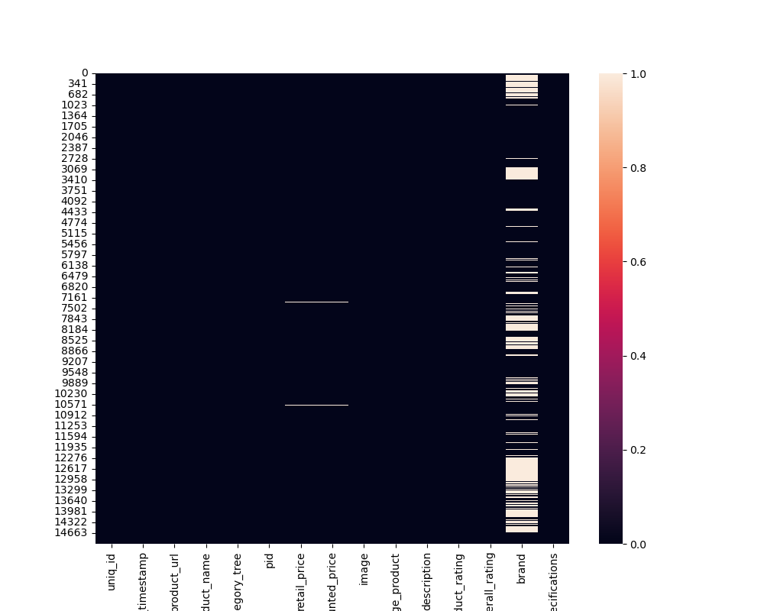
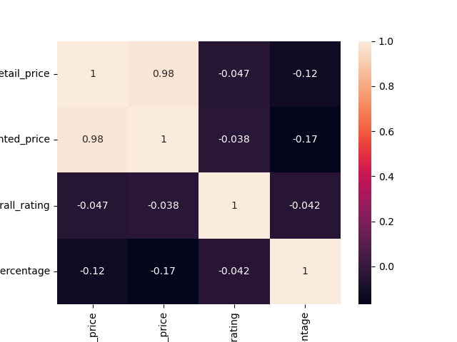
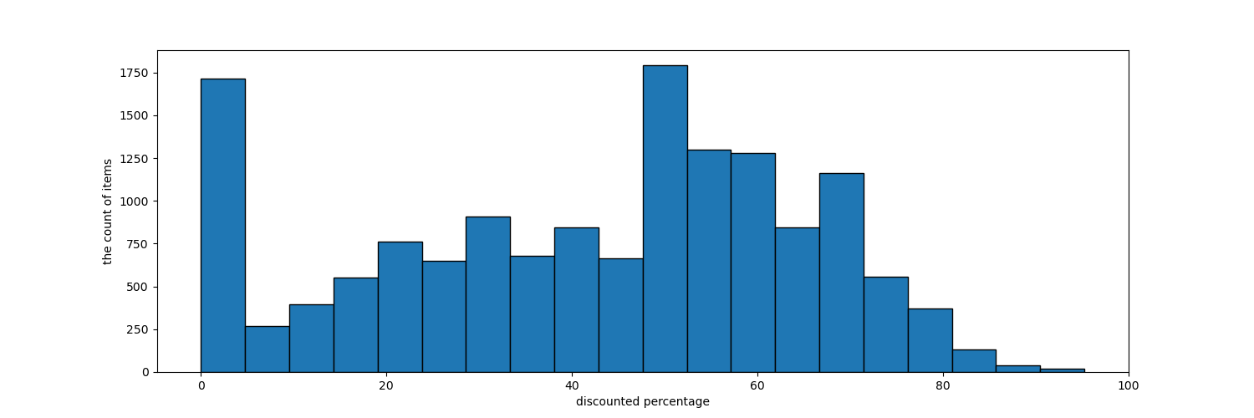
Data Visualization
Heatmap
Heatmap for null value
Histogram for Discount Percent

Slide 5
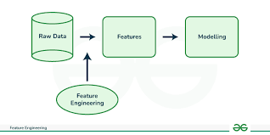
Feature Extraction
Feature extraction is a critical step in the process of data analysis, particularly in fields like machine learning, image processing, and natural language processing.

Slide 6
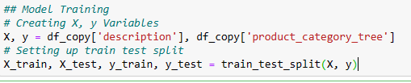
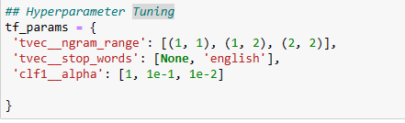
Model Training and Tuning
Model training is an iterative and comprehensive process that involves careful planning, execution, and continuous improvement. Hyperparameter tuning is the process of optimizing the hyperparameters of a machine learning model to improve its performance.

Slide 7

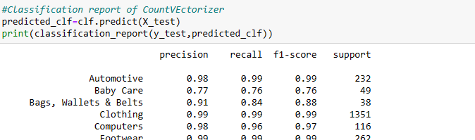
Model Evaluation and Result
The model's performance is evaluated on both the training and testing data using accuracy and a detailed classification report. This helps to understand how well the model has learned the training data and how it generalizes to unseen data.

Slide 8
Conclusion
This project has demonstrated the use of the TfidVectorizer Pipeline for machine learning model deployment and serving. The pipeline has been configured using appropriate parameters, and the process of model training, evaluation, deployment, and serving has been outlined. THANK YOU

